Slide 1


Computing Vision Market Entry Strategy
Pod 8: The Detroit Lions

Slide 2




Meet the Team!
Mason Wagner
Alex Cathcart
Sara Yun
Luis Fernando Saracho
Notes:
Sara: Strategy and analytics

Slide 3


Overview
01
04
Industry Overview
Recommendations
02
05
Key Questions
Next Steps
03
06
Data Understanding & Data Analysis
Q&A

Slide 4

Film Industry Overview
The film industry comprises of film producing companies, studios, screenwriting, festivals, and actors/actresses who collaborate to produce media for the consumer.
According to IMDB revenue data:
As of 2018, the total market size was $83,438,773,511
20 companies hold a 97% market share
Disney: 18%
Warner Brothers: 17.1%
Universal: 15.3%
Fox Studios: 12.5%

Slide 5
Key Questions
01
How much can you expect to gross domestically and globally?
02
What were the genres with the most movies from 2010-2018?
03
What movie genre will offer the most advantageous entry point into the market?

Slide 6


Data Overview
Data Sources
- IMDB: utilized movie rating information
IMDB
- TheMovieDB: utilized production budget
TheMovieDB
- The Numbers: utilized domestic gross, worldwide gross and studio
The Numbers
Notes:
After combining all data, we used 1378 movies

Slide 7
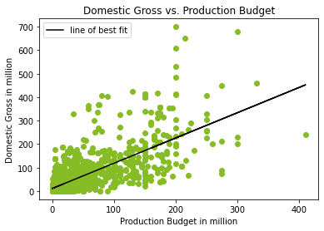
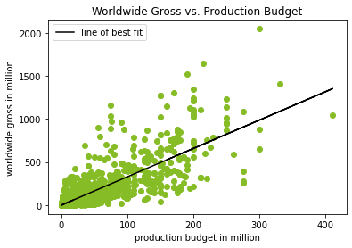

Data Analysis: Recommendation 1
How much can you expect to gross domestically and globally?
Insights
70% of variability in revenue can be attributed to production budget
Median production budget across genres is $25,000,000
Given a median production budget, we expect $27 million in domestic and $82.5 million in global gross revenue

Slide 8

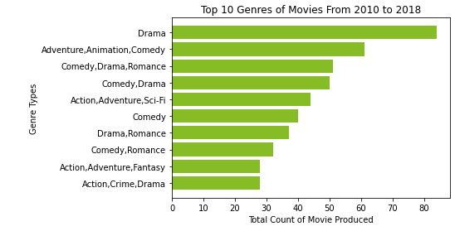
Data Analysis: Recommendation 2
What were the genres with the most movies from 2010-2018?
Insights
Drama tops the list of genres with over 80 different movies produced
Most movies are not considered one specific genre, but a mix of genres
The most common elements in the top 10 genres are action, drama, and comedy

Slide 9

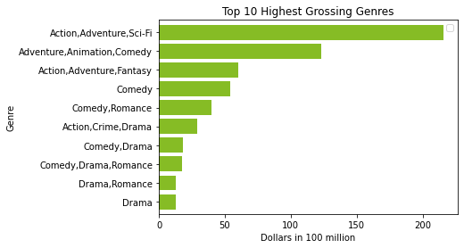
Data Analysis: Recommendation 3
What movie genre will offer the most advantageous entry point into the market?
Insights
Entry point should be a high grossing genre that hasn't been overexposed from 2010-2018
While Action, Adventure, Sci-Fi is the highest grossing genre, it is an oversaturated one
Action, Adventure, Fantasy and Action, Crime, Drama are quality candidates
Notes:
Thank you Alex,
Knowing the expecting gross from both domestic and worldwide, and popular genres, lets see the overall gross from each genres
This is a box diagram that shows the gross of each genres from previous top 10 genres
Entry point should be a high grossing genre that hasn’t been overexposed from 2010-2018
Compare to the previous figures, while action, adventure, sci-fi is the highest grossing genre, it is also one of the over saturated one.
On the other hand, Action, crime, drama is 10th place in last slides while it is placed in 6th grossing genres.
Action, adventure, fantasy is 9th place in last slides while it is placed in 3rd grossing genres
Action, adventure, fantasy and action, crime, drama are quality candidates
<next slide>

Slide 10
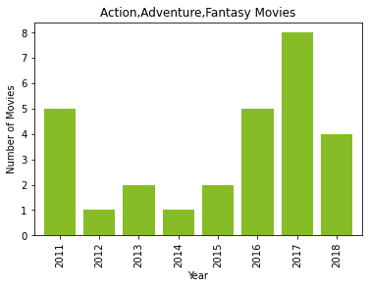
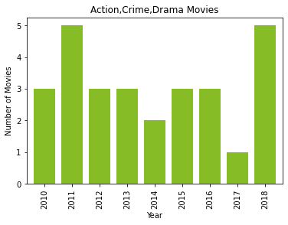
Data Analysis: Question 3 (cont.)
What movie genre will offer the most advantageous entry point into the market?
Insights
Entry point should be a high grossing genre that hasn't been overexposed from 2010-2018
While Action, Adventure, Sci-Fi is the highest grossing genre, it is an oversaturated one
Action, Adventure, Fantasy and Action, Crime, Drama are quality candidates
Notes:
This is the box diagram that shows the frequency of each genres through out 2011 to 2018
Action, adventure, fantasy movies show that frequency is increasing throughout time
Action, crime, drama movies show that frequency is stable through out time or we could even say that it is increasing towards 2017 to 2018
As a reference, action, adventure, fantasy movie includes Batman, Thor, and Doctor Strange
Action, crime, drama movie includes Baby Driver that released in 2017, Contraband from 2012
Now I will hand it over to Mason
<next slide>

Slide 11
Top 10 Genres with Grossing Genres

Slide 12
Recommendations
Having a budget greater than the median will most likely generate higher revenue.
The Action, Adventure, Fantasy and Action, Crime, Drama genres offer the best opportunity to successfully break into the film industry
8 out of 10 most popular genres blend elements of multiple genres
The market for Action, Adventure, Fantasy and Action, Crime, Drama are trending upwards

Slide 13
Next Steps
1
Based on our research, choose the genre for the movie
2
Generate the storyline and script, conduct market research on ideas
3
Set production budget and research directors and actors/actresses
4
Produce movie
5
Conduct research on methods of release (Theaters, streaming, TV, etc.)

Slide 14
Thank you! Questions?

